Slide 1
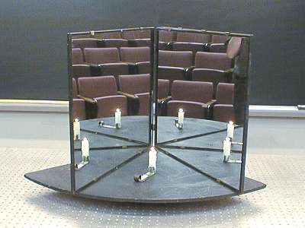
Section 16: Geometric Optics

Slide 2
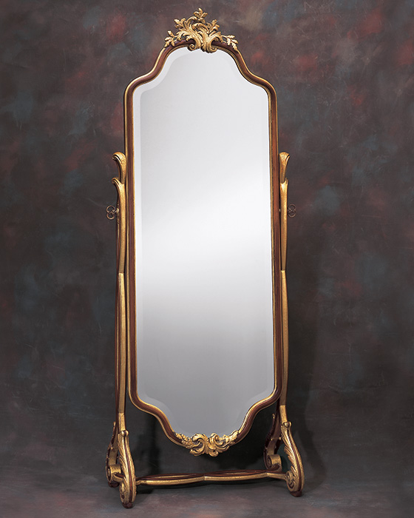
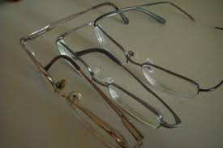
Goals
To study images formed by spherical mirrors
To study images formed by thin lenses

Slide 3
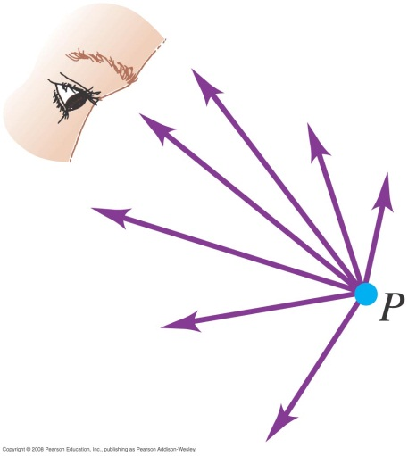
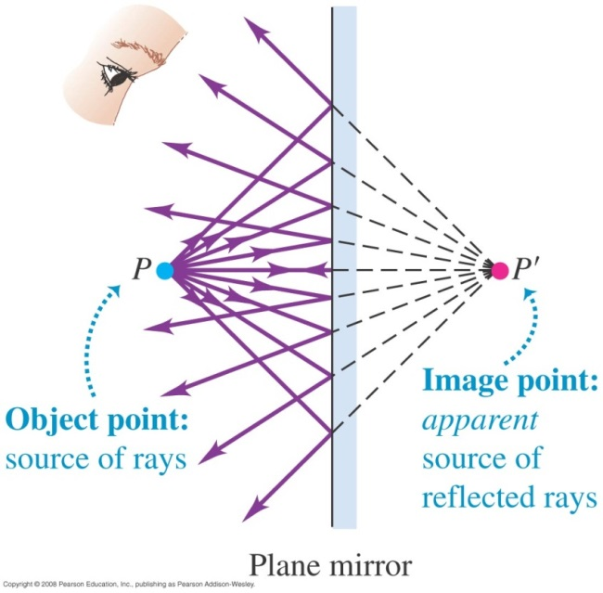
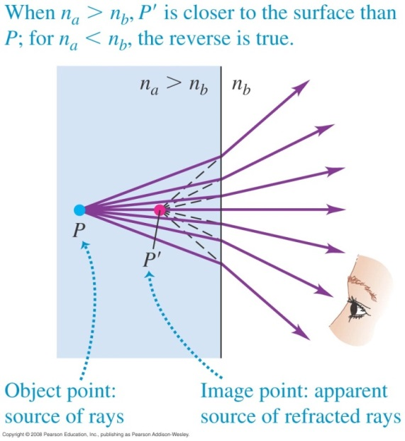
Objects, images, and light rays

Slide 4
Real vs. Virtual Images
Real image
Created by actual light rays meeting
Virtual image
Image created by outgoing rays which don’t actually pass through a point (but appear to!)

Slide 5
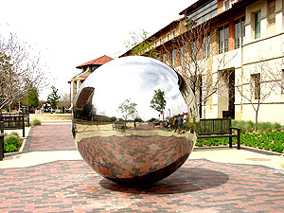
Mirrors: Image by Reflection

Slide 6
Mirror Demos with Laser

Slide 7
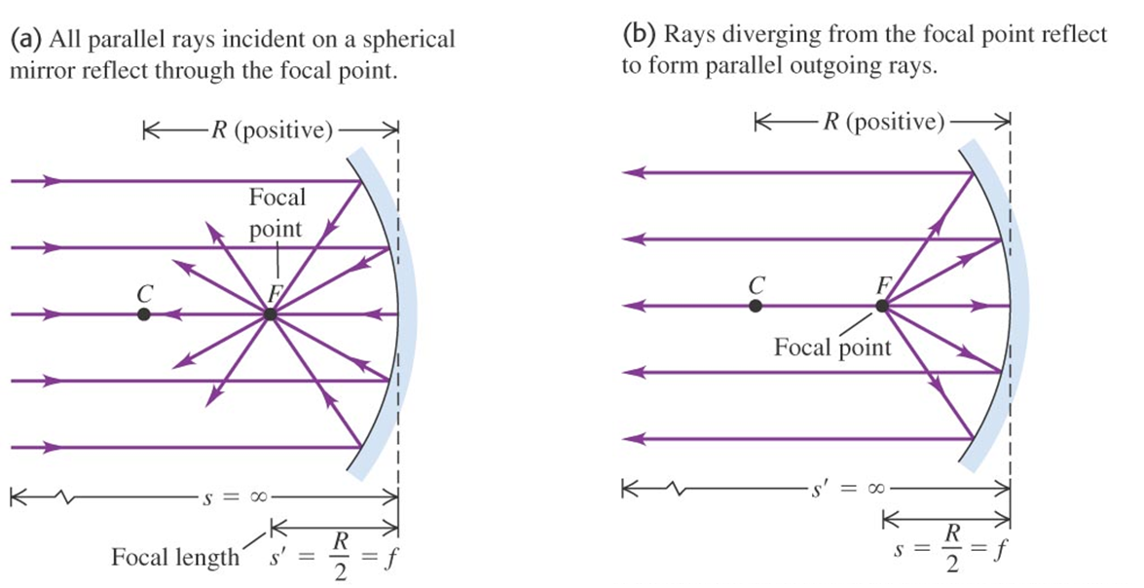

Focal Length
$$f=\frac{R}{2}$$

Slide 8

Spherical Mirror Equation
$$\frac{1}{s}+\frac{1}{s^{′}}=\frac{1}{f}$$
$s$ is the object distance
$s^{′}$ is the image distance
$f$ is the focal length

Slide 9
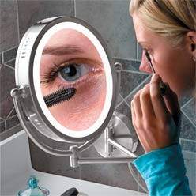

Magnification
$$m≡\frac{y^{′}}{y}=−\frac{s^{′}}{s}$$

Slide 10
Handout: Geometric Optics Summary

Slide 11
Mirrors: Examples

Slide 12
Activity: Mirrors

Slide 13
Demo
Large Concave Mirror
Watch object (you) as it goes inside the focal point!

Slide 14
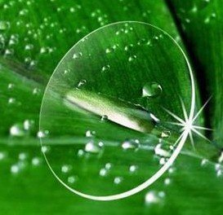
Lenses: Image by Refraction

Slide 15
Lenses: Laser Demos

Slide 16
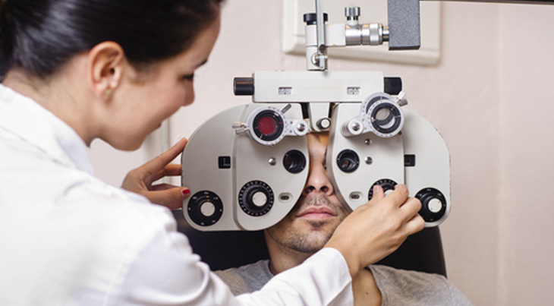

Lensmaker’s Equation: Determining the Focal Length
$$\frac{1}{f}=(n−1)\left(\frac{1}{R_{1}}−\frac{1}{R_{2}}\right)$$

Slide 17
Example: Lensmaker’s Equation

Slide 18
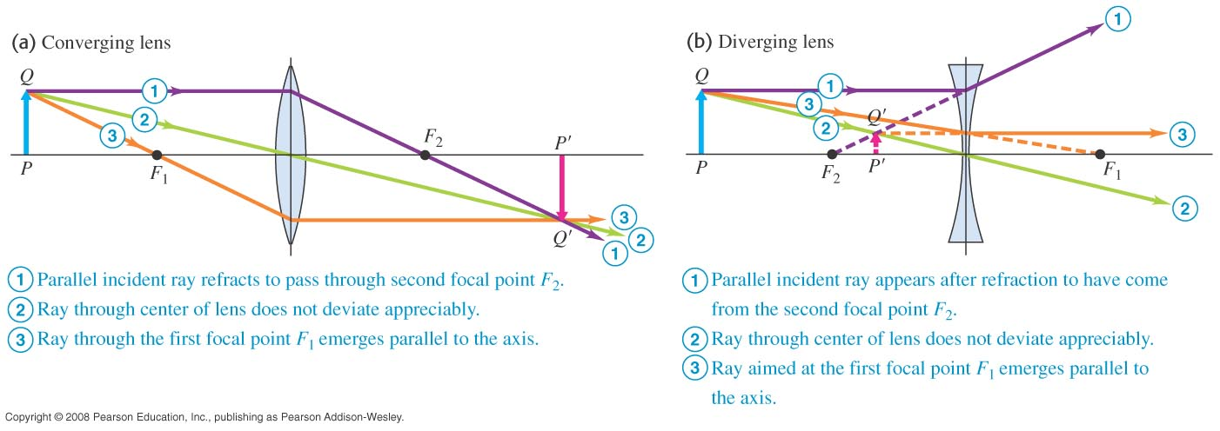
Principal Rays and Ray Diagrams

Slide 19

Thin Lens Equation and Magnification
$$\frac{1}{s}+\frac{1}{s^{′}}=\frac{1}{f}$$
$$m=−\frac{s^{′}}{s}$$

Slide 20
Lenses: Examples

Slide 21
Activity: Lenses

